Slide 1
EE675: COURSE PROJECT COST-AWARE CASCADING BANDITS Instructor : Prof. Subrahmanya Swamy Peruru
Video link - Link to our presentation
PRESENTED BY :
RAJVARDHAN VERMA (210819)
ROHIT RAJ (210874)
Saurabh Vishwakarma (210949)

Slide 2
What is the Cascading bandit problem?
Cascading Bandit is an online learning variant of the cascade model where the goal is to recommend K most attractive items from a large set of L candidate items
Sequential Decision Making: In the cascading bandit problem, decisions are made sequentially, where the outcome of choosing one arm influences the choices and rewards of subsequent arms.
Complex Reward Structure: Unlike traditional bandit problems, the cascading bandit introduces a more intricate reward structure, where rewards are not only based on immediate choices but also on the entire sequence of choices made

Slide 3
What is the Cascading bandit problem?
Cascading Bandits in Recommendation Systems: In this model, users sequentially evaluate items from a recommended list. They click on an item if attracted, otherwise, they move to the next. The objective is to learn the unknown click probabilities of items to optimize the recommendation list efficiently.

Slide 4



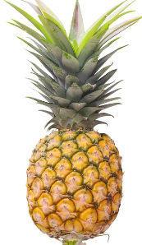



What is the Cascading bandit problem?
Recommended Items
x
K=3
Attractiveness
W(i)
L= 6
0
1
K`=2

Slide 5
COST-AWARE CASCADING BANDITS

Slide 6
COST-AWARE CASCADING BANDIT
Cost-aware cascading bandits are a type of multi-armed bandit problem where the aim is to optimize not just the reward but also the cost associated with each action. In a traditional multi-armed bandit problem, the goal is to maximize the total reward obtained by pulling arms (or taking actions) over time, without considering any costs associated with those actions.
In the context of cost-aware cascading bandits, the problem becomes more complex. Here's how it works:
1. Rewards and Costs: At each stage, the decision-maker receives a reward if they decide to proceed to the next stage. However, they also incur a cost associated with taking the action. The goal is to maximize the cumulative reward while minimizing the cumulative cost over multiple stages.

Slide 7
COST-AWARE CASCADING BANDIT
2. Cascading Effect: The decision to proceed to the next stage depends on the outcome of the previous stage. If the reward obtained at a stage is below a certain threshold or the cost is too high, the decision-maker may decide to stop and not proceed to the next stage.
The challenge in cost-aware cascading bandits lies in balancing the trade-off between maximizing rewards and minimizing costs over multiple stages. Traditional bandit algorithms need to be adapted or extended to handle this additional complexity.
Applications of cost-aware cascading bandits can be found in various domains such as online advertising, recommendation systems, and healthcare, where decisions need to be made considering both rewards (e.g., user engagement, revenue) and costs (e.g., click-through rates, operational costs).

Slide 8
COST-AWARE CASCADING BANDIT
PROBLEM SETUP
Arm Set: Consider a set of K items (arms) denoted as [K] = {1, 2, ..., K}.
Item States: Each item i ∈ [K] has two states: 0 and 1.States evolve based on an i.i.d. Bernoulli random variable.
Learning Agent Action: Chooses an ordered list of items in each step. Examines items sequentially until a stopping condition is met.
Reward Mechanism: Receives a reward of one if any examined item has state 1. Otherwise, the reward is zero.
Cost Association: Each item examination incurs a random cost.
Net Reward Function: Calculated as the reward obtained minus the total examination costs incurred before stopping

Slide 9
PROBLEM STATEMENT
Given the complexities arising from cost considerations, various algorithms have emerged to pinpoint the arm with the highest anticipated net reward efficiently. In this study, our focus shifts to determining the number of samples necessary for a specific algorithm tailored for the CACB problem. Grasping the sample requirements of this algorithm is pivotal in understanding its feasibility and adaptability in practical scenarios.
Thus, the principal aim of this research is to ascertain the number of samples needed by the selected CACB algorithm to identify the best arm with high probability. Through this investigation, we aim to offer invaluable insights into its sampling requirements, facilitating its refinement and adaptation across a range of applications.

Slide 10
BASE RESEARCH PAPER: BEST ARM IDENTIFICATION IN CASCADING BANDITS

Slide 11
Base Research Paper: Best Arm In Cascading Bandits
INTRODUCTION
This paper presents an algorithm called CASCADEBAI, which finds the best set of K items, called an arm, within the framework of Cascading bandits.
An upper bound on the time complexity of CASCADEBAI is derived, by probabilistically estimating the amount of available feedback at each step.
The paper establishes a lower bound on the time complexity of any best arm identification (BAI) algorithm in cascading bandits, to show that the performance of CASCADEBAI(ε, δ, K) is optimal in some cases.
Extensive numerical simulations were performed to corroborate the efficacy of CASCADEBAI as well as the tightness of our upper bound on its time complexity.

Slide 12
Base Research Paper: Best Arm In Cascading Bandits
PROBLEM SETUP
The paper is defined for the fixed-confidence setting in cascading bandits, and our analysis provides tools for handling the statistical dependence between the amount of feedback and that of time steps in the cascading bandit setting.
The problem involves selecting the most promising items among a set of L ∈ N ground items, each associated with a click probability w(i) ∈ [0,1].
At each time step t, the agent pulls an arm of K items chosen from the ground items, i.e., S_{t} := (i^{t}₁,i^{t}₂,….., i^{t}_{K}) ∈ [L]^{(K)}.
The feedback O_{t} from the user is defined as a vector in {0, 1, *}^{K} , where 0, 1, * represents observing no click, observing a click and no observation respectively.

Slide 13
Base Research Paper: Best Arm In Cascading Bandits
PROBLEM SETUP (Contd...)
Items are considered optimal if their click probability is greater than or equal to the Kth highest click probability. We assume w(K) > w(K+1) to ensure there are exactly K optimal items, i.e., [K] = {1, 2, …. K} = {i ∈ [L] : w(i) ≥ w(K)}
An item is ε-optimal if it's click probability is close to the Kth highest click probability within a tolerance ε.

Slide 14
Base Research Paper: Best Arm In Cascading Bandits
ALGORITHM
A deterministic and non-anticipatory online algorithm consists in a triple π := ((π_{t})_{t}, T^{π}, φ^{π}) in which:
Sampling rule(π_{t})_{t} : Determines which arm to pull at each time step
Stopping rule T^{π} : Decides when to terminate the algorithm
Recommendation rule φ^{π} : Selects the arm S^{π} to choose eventually
GOAL: To obtain a (δ, K)-PAC algorithm π such that E^{w}T^{π} is small and T^{π} is small with high probability.

Slide 15
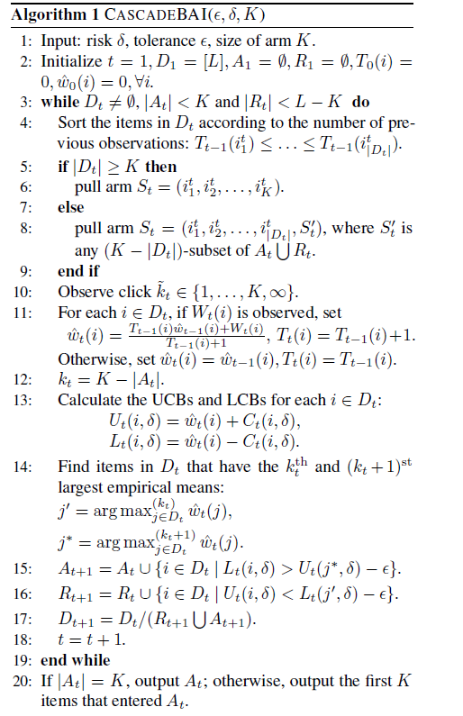

Base Research Paper: Best Arm In Cascading Bandits
CASCADEBAI(ε, δ, K) Algorithm
D_{t} : Survival set at time t
A_{t} : Accept set
R_{t} : Reject set
T_{t}(i) : Number of observations of item i by time step t
w^_{t}(i) : empirical mean

Slide 16
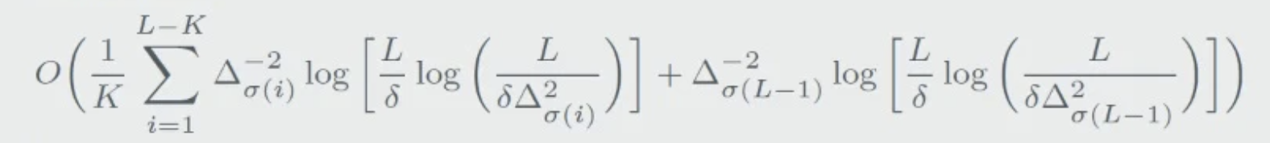
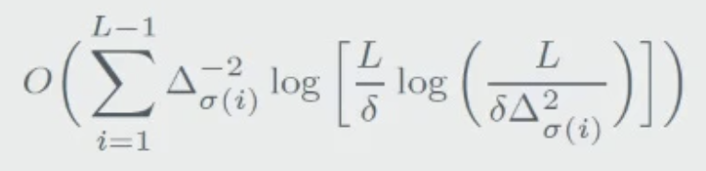
Base Research Paper: Best Arm In Cascading Bandits
MAIN RESULTS:
PART 1: (Upper Bound in Special Cases)
If all w(i)'s are atmost 1/K, with probablity atleast 1 - δ, our algorithm outputs S* after atmost
steps.
If all w(i)'s are atleast ½, with probability atleast 1 - δ, our algorithm outputs S* after atmost
steps.

Slide 17
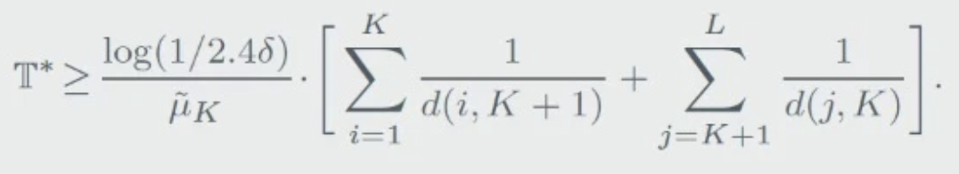
Base Research Paper: Best Arm In Cascading Bandits
MAIN RESULTS:
PART 2: (Lower Bound)
We have
µ_{k} ≤ min{1/w', K}
d(m,n) = KL(w(m), w(n)) ; KL(p, q) = p log(p/q) + (1-p) log(1-p/1-q)

Slide 18
OTHER RESEARCH PAPERS

Slide 19
OTHER RESEARCH PAPERS
Title: Cost Aware best arm Identification
Authors: Kellen Kanarios, Qining Zhang and Lei Ying
Objective : Address the Cost Aware Best Arm Identification (CABAI) problem in multi-arm bandit setups. This problem integrates both rewards and cost distributions for each arm, aiming to identify the highest reward arm while minimizing costs. It captures the shift from cost-focused testing to reward-focused implementation in product development.
Key Questions:
Sampling arms during testing with unknown costs.
Identifying the best arm (stopping rule).
Selecting the arm for implementation (decision rule).
The algorithm proposed in the paper basically addresses the above rule to obtain best arm

Slide 20
OTHER RESEARCH PAPERS
Contribution:
Introduction of CABAI, highlighting its differences from traditional Best Arm Identification (BAI) problems.
Demonstration that BAI algorithms are sub-optimal for CABAI due to neglecting heterogeneous arm costs.
Propose CTAS and CO algorithms:
CTAS: Matches a non-asymptotic lower bound on cumulative cost and reward.
CO: A low-complexity algorithm based on the Chernoff Overlap principle, showing promising empirical and theoretical results.

Slide 21
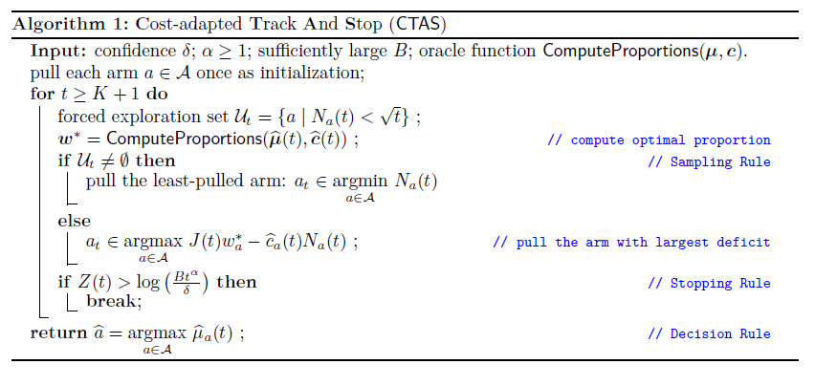
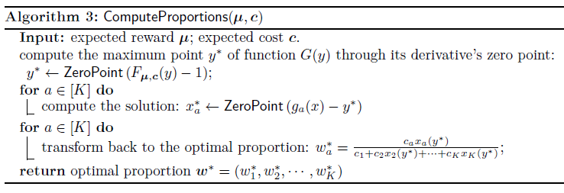
OTHER RESEARCH PAPERS
The CTAS algorithm aims to identify the arm with the highest reward while considering its associated cost. It begins with an initialization step where each arm is pulled once. In each subsequent time step, the algorithm computes the forced exploration set and the optimal proportion of arms to sample based on the current rewards and costs. If the forced exploration set is non-empty, the algorithm selects the least-pulled arm; otherwise, it chooses the arm with the largest deficit in reward-cost ratio. The algorithm employs a stopping rule to terminate the process if a certain condition related to the cumulative cost Z(t) is met. Finally, the decision rule returns the arm with the highest estimated reward.
To Computing W* Efficiently

Slide 22
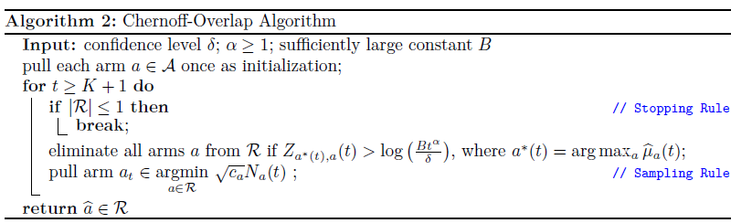
OTHER RESEARCH PAPERS
CONCLUSION
In this work, we introduced a new MAB problem: Cost-Aware Best Arm Identification. We provided a new lower bound and an asymptotically optimal cost-adapted BAI algorithm. Finally, we introduced a low-complexity algorithm with promising empirical results. As a future direction, it may be interesting to explore how this algorithm can be adapted to the regret setting in either the cost adapted setting (Sinha et al., 2020), or as an ETC algorithm for carefully chosen costs

Slide 23
OTHER RESEARCH PAPERS
Topic: Cost-Aware Cascading Bandit
Authors: Chao Gan , Ruida Zhou, Jing Yang , Member, IEEE, and Cong Shen , Senior Member, IEEE
Objective: The paper introduces the Cost-Aware Cascading Bandit framework, focusing on optimizing the expected net reward under different cost settings. The objective is to develop algorithms that efficiently balance exploration and exploitation to maximize cumulative rewards while considering costs.
Methodology: The paper begins by presenting the system model and then delves into scenarios with known and unknown instantaneous costs. Specifically, the case of Unknown Immediate Reward in the optimal offline policy is explored, where the cost of pulling each arm is unknown until it is pulled. The learner needs to learn the statistics of rewards and costs through observed arm states and costs.

Slide 24
OTHER RESEARCH PAPERS
Assumptions 1:
1) θ_{i} ≠ c_{i}, for all i ∈ [K].
2) There exists a constant ε > 0, such that c_{i} > ε for all i ∈ [K].
Under these assumptions, the optimal offline policy, named Unit Cost Ranking with Threshold 1 (UCR-T1), is presented in Theorem 1. This policy ranks the expected reward normalized by the average cost and compares it against a threshold. The violation of Assumption 1.1 would lead to a non-unique optimal offline policy.

Slide 25
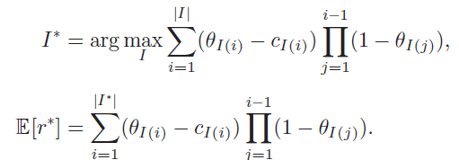
OTHER RESEARCH PAPERS
Expected Net Reward Structure:
The expected net reward structure in the Cost-Aware Cascading Bandit framework is more complex than traditional multi-armed bandit problems or standard cascading models. The detailed formulation of the expected net reward structure is provided in the paper

Slide 26

OTHER RESEARCH PAPERS
Theorem 1: Arrange the arm indices such that
, where I* is the ordered list under the optimal offline policy
Then, I* = {1*, 2*, …...,L*},
Theorem 1 indicates that ranking the arms in a descending order of θi/ci and only including those with θi /ci >1 in I* achieves a balanced trade-off between maximizing the expected net reward from the current arm (i.e θi_{i} − ci) and maximizing the cumulative net reward from the remaining arms in I* if the current arm has state 0.

Slide 27
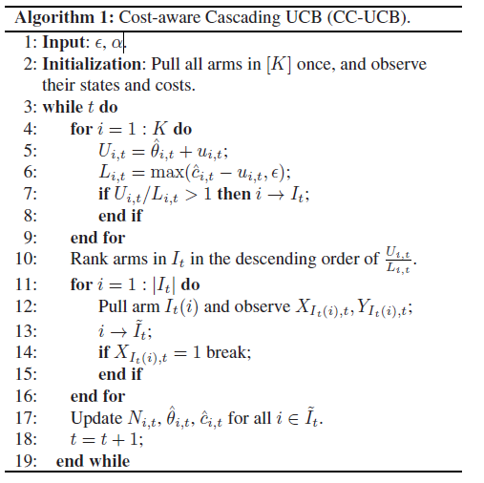

OTHER RESEARCH PAPERS
Online Algorithm and Upper Bound
The algorithm begins by taking inputs and α. In the initialization step, each arm in the set [K] is pulled once, and their states and costs are observed. The algorithm enters a loop where it iteratively updates and evaluates each arm. For each arm, it calculates upper and lower confidence bounds (U_{i,t} and L_{i,t} respectively) based on their observed states and costs. If the ratio of U_{i,t} to L_{i,t} exceeds 1, the arm is added to the set It. The arms in It are then ranked in descending order of their U_{i,t}/L_{i,t} ratio. The algorithm pulls the arms in this ranked set sequentially until it observes a successful pull (XIt(i),t =1). After pulling, it updates the estimates for the arms in the set ˜It and increments the time step t. The loop continues until the specified condition is met, or a break condition occurs.

Slide 28
OTHER RESEARCH PAPERS
CONCLUSION
In this paper, we studied a CCB model by taking the cost of pulling arms into the cascading bandits framework. We considered two different scenarios, depending on the availability of the immediate costs.
For each scenario, we first explicitly characterized the optimal offline policy, and then developed a UCB based algorithm for the online setting.
We analyzed the regret behavior of the proposed CC-UCB and CC-UCB2 algorithms, and showed that they are order-optimal.
An extension to incorporate end-game failure was also studied. Experiments using both synthetic data and real-world data were carried out to evaluate the algorithms.

Slide 29
FUTURE PLANS

Slide 30
FUTURE PLAN
In the cost-aware cascading bandits variant, the objective is not only to identify the best arm but also to consider the cost associated with each arm. This adds another layer of complexity to the problem because now not only do we want to maximize the reward but also to minimize the cost incurred during the exploration process.
To answer the question of how many samples are required to identify the best arm with high probability in the cost-aware cascading bandits setting, we would likely need to conduct a similar analysis as in the original cascading bandits problem but incorporate the cost aspect into the analysis.
So, we are breaking down the problem into manageable steps that will help us to tackle this problem:

Slide 31
FUTURE PLAN
LITERATURE REVIEW
We will do an in-depth review of existing literature on regret analysis in bandit algorithms, particularly focusing on the UCB-based algorithms and those that incorporate cost considerations.
Identify any related work that addresses regret caused by pulling arms in the wrong order or considers both reward and cost aspects simultaneously.
REGRET DECOMPOSITION
We have to breakdown the regret into two components: regret caused by pulling arms with low rewards (θ_{i} < c_{i}) and regret caused by pulling arms in the wrong order.
Develop mathematical formulations for each component of regret and understand their interplay.

Slide 32
FUTURE PLAN
THEOROTICAL ANALYSIS
We will need to derive theoretical bounds on each component of regret separately, considering the characteristics of the CC-UCB algorithm.
And investigate the effect of the UCB padding term (ui,t) and other parameters on the regret bounds.
OUR CONTRIBUTION
Finally, we will try to address the technical challenges associated with analyzing the regret caused by pulling arms in the wrong order, which may require novel insights and approaches.
We will also try new theoretical frameworks or extend existing ones to handle this aspect of regret in the context of bandit algorithms.

Slide 33
THANK YOU !

